Slide 1





Course Name object oriented analysis and design
CSC 2210
(Undergraduate)
Software engineering (Undergraduate)
Course Orientation and General discussion
Chapter 1 why do we model things?
Victor Stany Rozario
Assistant Professor And Special Assistant
Department Of Computer Science, AIUB
Web: https://cs.aiub.edu/profile/stany

Slide 2
Lecture Outline
Lecture Outline
Victor Stany Rozario
S.2
General Discussion and Course Orientation
Course Objectives
Course Requirements
Text Books & References
Assessments Criteria and Marks Distribution
Classroom and grading policies

Slide 3
Contact Details
Contact Details
Victor Stany Rozario
S.3
Victor Stany Rozario
Assistant Professor and Special Assistant
Department of Computer Science
FST, AIUB
Email – stany@aiub.edu
Office – DNGA02

Slide 4
Objectives
Objectives
Victor Stany Rozario
S.4
• Explain the necessity of formal modelling techniques in system development
• Describe system analysis and design using object-oriented concepts and techniques
• Quote the UML building blocks along with their notations
• Demonstrate the use of object-oriented analysis concept with UML diagrams
• Solve complex engineering problems using UML concepts and tools

Slide 5
Course Requirements
Course Requirements
Victor Stany Rozario
S.5
These are the things need to be accomplished properly by the students during the term such as:
Attending at least 80% of the classes
Attending quizzes.
Submission of the assignments, project in due time, etc.

Slide 6
Textbook / References
Textbook / References
Victor Stany Rozario
S.6
1. The Unified Modeling Language User Guide by Grady Booch, James Rumbaugh, Ivar Jacobson
2. UML Weekend Crash Course by Thomas A Pender
3. Head first design patterns by Eric Freeman, Elisabeth Freeman, Kathy Sierra, Bert Bates
4. Design Patterns- Elements of Reusable Object-Oriented Software by Eric, Gamma, Richard Helm, Ralph Johnson, John Vlissides
5. An Integrated Approach to Software Engineering by PankajJalote
6. Object Oriented Software Engineering-Ivar Jacobson, Magnus Christerson, Patrik Jonsson, Gunnar Overgaard
7. The Unified Modeling Language Reference Manual by Grady Booch, James Rumbaugh, Ivar Jacobson
8. Object Oriented System Analysis and Design, Second Edition by Grady Booch

Slide 7
Mid Term and Final Term Assessments
Mid Term and Final Term Assessments
Victor Stany Rozario
S.7
Term Assessments | Term Written Exam (MCQ + Diagram Drawing) | 50%
 | Quizzes | 40%
 | Attendance & Performance | 10%
TOTAL |  | 100
Grand Total | 40% of Midterm + 60% of Final Term

Slide 8
Classroom Policies
Classroom Policies
Victor Stany Rozario
S.8
Must join the class in due time.
Students are suggested to ask questions during or after the lecture.
Do not hesitate to ask any question any number of time about the lecture
*** Additional/bonus marks may be given to any good performances during the class.

Slide 9
Grading Policies
Grading Policies
Victor Stany Rozario
S.9
All the evaluation categories & marks will be uploaded to the VUES within one week of the evaluation process except the attendance & performance, which will be uploaded along with the major (mid/final term) written exam marks.
Letter grades ‘A+’ through ‘F’ is counted as grades. Other grades ‘I’ and ‘UW’ are considered as temporary grades which are counted/calculated as ‘F’ grade in the CGPA. These grades must/will be converted to the actual grades, i.e. ‘A+’ through ‘F’.
‘I: INCOMPLETE’ is given to students who have missed at most 30% of evaluation categories (quiz/assignment/etc.). Students must contact the course teacher for makeup, through valid application procedures immediately after grade release.
‘UW: UNOFFICIAL WITHDRAW’ is given when the missing evaluation categories are too high (more than 30%) to makeup. A student getting ‘UW’ has no option but to drop the course immediately after grade release

Slide 10
IMPORTANT!!
IMPORTANT!!
Victor Stany Rozario
S.10
Never Come to my office or send me messages/emails with the request for an extra grade.
Never miss any deadline.
Marks will be deducted, even worse can happen if you copy assignment/project

Slide 11

Welcome
Victor Stany Rozario
S.11
WELCOME TO
OBJECT ORIENTED ANALYSIS AND DESIGN

Slide 12
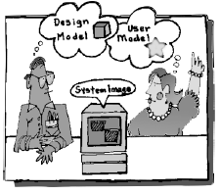
Why we model?
Chapter 1: Why do we Model things
Victor Stany Rozario
S.12
A model is a simplification of reality
A model provides the blueprints of a system.

Slide 13
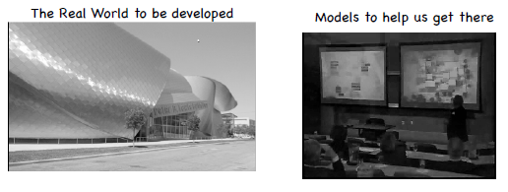
Why we model?
Chapter 1: Why do we Model things
Victor Stany Rozario
S.13
The larger and more complex the system, the more important modelling becomes, for one very simple reason: We build models of complex systems because we cannot fully mean of such a system in its entirety.
There are limits to the human ability to understand complexity. Through modelling we narrow the problem we are studying by focusing on only one aspect at a time.

Slide 14
Why we model?
Chapter 1: Why do we Model things
Victor Stany Rozario
S.14
Modeling is the designing of software applications before coding.
Modeling is an Essential Part of large software projects, and helpful to medium and even small projects as well.
Modelling is a proven and well-accepted engineering technique.
Unsuccessful software projects fail in their own unique ways, but all successful projects are alike in many ways.
There are many elements that contribute to a successful software organization; one common thread is the use of modelling.
We do model so that we can better understand the system we are developing.

Slide 15
Benefits of model
Chapter 1: Why do we Model things
Victor Stany Rozario
S.15
Through modelling we achieve four aims:
Models help us to visualize a system as it is or as we want it to be
Models permit us to specify the structure or behaviour of a system
Models give us a template that guides us in constructing a system
Models document the decisions we have made

Slide 16
Limitation of Human Ability
Chapter 1: Why do we Model things
Victor Stany Rozario
S.16
The larger and more complex the system, the more important modelling becomes, for one very simple reason:
We build models of complex systems because we cannot comprehend such a system in its entirety.
There are limits to the human ability to understand complexity. Through modelling we narrow the problem we are studying by focusing on only one aspect at a time.

Slide 17
Principles of Modelling – 1st
Chapter 1: Why do we Model things
Victor Stany Rozario
S.17
The choice of what models to create has a profound influence on how a problem is attacked and how a solution is shaped.
-In other words, choose models intelligently.
The right models will illuminate the wicked development problems.

Slide 18
Principles of Modelling – 2nd
Chapter 1: Why do we Model things
Victor Stany Rozario
S.18
Every model may be expressed at different levels of precision.
- Sometimes a quick and simple executable model of the user interface is exactly what you need; at other times, one has to get down and dirty with the bits. In any case, the best kinds of models are those that let you choose your degree of detail, depending on who is viewing and why they need to view it.

Slide 19
Principles of Modelling – 3rd
Chapter 1: Why do we Model things
Victor Stany Rozario
S.19
The best models are connected to reality.
- A Model connected to reality makes it more understandable and presentable. The more abstract a model is the more it needs to be closer to reality.

Slide 20
Principles of Modelling – 4th
Chapter 1: Why do we Model things
Victor Stany Rozario
S.20
No single model is sufficient.
- Every nontrivial system is best approached through a small set of nearly independent models.

Slide 21
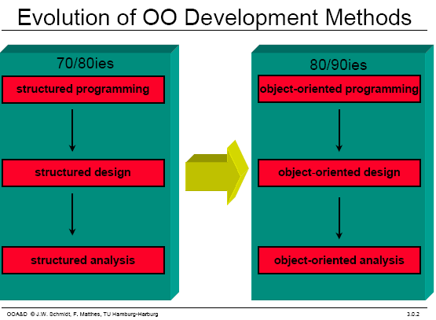
Software development evolution
Chapter 1: Why do we Model things
Victor Stany Rozario
S.21

Slide 22
UML
Chapter 1: Why do we Model things
Victor Stany Rozario
S.22
Unified Modeling Language
UML is a standardized general-purpose modeling language in the field of software engineering. The standard is managed, and was created by, the Object Management Group (OMG) (http://www.omg.org/)
UML website: http://www.uml.org
Why do you use UML?
Standardized graphical notation for Specifying, Visualizing, Constructing, and Documenting software systems
Increase understanding/communication of product to customers and developers
Support for UML in many software packages today (e.g., UMLet, Rational Rose, ArgoUML, etc.)

Slide 23
The UML is a language for Visualizing
Chapter 1: Why do we Model things
Victor Stany Rozario
S.23
Some things are best modeled textually; others graphically
The UML is more than just a bunch of graphical symbols
One developer can write a model in the UML, and another developer, or even another tool, can interpret that model unambiguously

Slide 24
The UML is a language for Specifying
Chapter 1: Why do we Model things
Victor Stany Rozario
S.24
Specifying means building models that are precise, unambiguous, and complete
In particular, the UML addresses the specification of all the important analysis, design, and implementation decisions that must be made in developing and deploying a software-intensive system.

Slide 25
The UML is a language for Constructing
Chapter 1: Why do we Model things
Victor Stany Rozario
S.25
UML is not a visual programming language, but its models can be directly connected to a variety of programming languages
It is possible to map from a model in the UML to a programming language such as Java, C++, or VB, or even to tables in a RDBMS

Slide 26
The UML is a language for Documenting
Chapter 1: Why do we Model things
Victor Stany Rozario
S.26
The UML addresses the documentation of a system’s architecture and all of its details
The UML also provides a language for expressing requirements and for tests
Finally, the UML provides a language for modeling the activities of project planning and release management

Slide 27

Building blocks of uml
Chapter 1: Why do we Model things
Victor Stany Rozario
S.27
The vocabulary of the UML include three kinds of building blocks:
Things - abstractions that are primary concern in a model (John, Jesmin, Joseph, Jessy)
Relationships - tie these things together (Father, Mother, Daughter, Son)
Diagrams - group collections of things (Happy Family)

Slide 28
Things in uml
Chapter 1: Why do we Model things
Victor Stany Rozario
S.28
Structural things
nouns/static parts of UML models (irrespective of time)
Behavioral things
verbs/dynamic parts of UML models
Grouping things
organizational parts of UML models
Annotation things
explanatory parts of UML models

Slide 29
Structural things
Chapter 1: Why do we Model things
Victor Stany Rozario
S.29
Structural things are the nouns of the UML model. These are the mostly static parts of a model, representing elements that are either conceptual or physical. There are seven kinds of structural things.
1. A Class
A class can be defined as a template/blueprint that describes the behaviors/states that object of its type support.
Description of set of objects that share the same attributes, operations, relationships and semantics
Student
Name ID CGPA DOB
Study ( ) Play ( ) Eating ( )

Slide 30
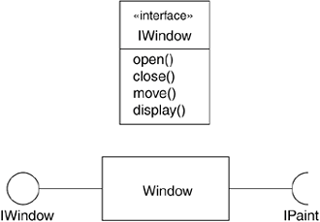
Structural things
Chapter 1: Why do we Model things
Victor Stany Rozario
S.30
2. An interface
Is a collection of operations that specify a service of a class or component. An interface therefore describes the externally visible behavior of that element.
You cannot instantiate an interface. Therefore, interface does not contain any constructors.
An interface is not extended by a class; it is implemented by a class (unchanged in implementation).
An interface can extend multiple interfaces.
Interface

Slide 31

Structural things
Chapter 1: Why do we Model things
Victor Stany Rozario
S.31
3. A collaboration: A collection of UML building blocks (classes, interfaces, relationships) that work together to provide some functionality within the system. (e.g., Interoperability, block chain technology to conned external system in providing one-stop e-services
4. A Use case is a description of set of sequence of actions that a system performs that yields an observable result of value to a particular actor.
Registration Course

Slide 32
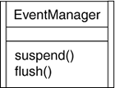
Structural things
Chapter 1: Why do we Model things
Victor Stany Rozario
S.32
5. An active class
is a class whose objects (known active object) own one or more processes or threads and therefore can initiate control activity (modify variables, change program behavior, and so on).
Active object initiate and control the flow of activity, while passive object wait for another object to call them generally for store data and serve other classes.
Graphically, an active class is rendered as a class with double lines on the left and right

Slide 33
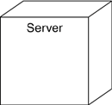
Structural things
Chapter 1: Why do we Model things
Victor Stany Rozario
S.33
6. A Component is a packaging of classes, interfaces, and collaboration. Total program is divided into various parts or module.
7. A Node: Computational resources that exists at run time, typically h/w resources e.g., memory, processor, etc.
Course.cpp

Slide 34
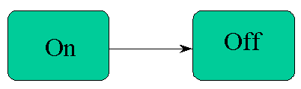
behavioral things
Chapter 1: Why do we Model things
Victor Stany Rozario
S.34
These are the verbs of a model.
Dynamic parts of UML models.
Representing behavior over time and space.
There are two kinds of behavioral things
1. Interaction: A set of object exchanging messages to accomplish a specific purpose
2. A state machine: specifies the sequence of states that an object or an interaction goes through during its lifetime in response to events.
Msg: Vacation
Study
Vacation
Msg: Study

Slide 35
grouping things
Chapter 1: Why do we Model things
Victor Stany Rozario
S.35
The organizational parts of UML models. These are the boxes into which a model can be decomposed. There is one primary kind of grouping thing, namely, packages.
Organizing elements (structural/behavioral) into groups.
Purely conceptual. only exists at development time. And can be nested.
Variations of packages are: Frameworks, models, & subsystems.
University Administration
Course Manager
Student Admission
-Student
+Department

Slide 36
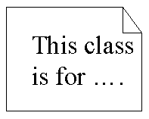

Annotational things
Chapter 1: Why do we Model things
Victor Stany Rozario
S.36
Annotational things are the explanatory parts of UML models.
These are the comments you may apply to describe, illuminate, and remark about any element in a model.
There is one primary kind of Annotational thing, called a note.

Slide 37
Relationships in uml
Chapter 1: Why do we Model things
Victor Stany Rozario
S.37
There are four kinds of relationships in the UML
Association
Generalization
Realization
Dependency
Association: is a structural relationship that describes a set of links. A link is a connection between objects.
Student
attends
University

Slide 38
Relationships in uml
Chapter 1: Why do we Model things
Victor Stany Rozario
S.38
Generalization: can be defined as a relationship which connects a specialized element with a generalized element. It basically describes inheritance (IS-A) relationship in the world of objects.
Student registration
parent
child
under-graduate
registration
graduate
registration

Slide 39


Relationships in uml
Chapter 1: Why do we Model things
Victor Stany Rozario
S.39
Realization: denotes the implementation (interface) of the functionality defined in one class by another class.
Dependency: is a relationship between two things in which change in one element also affects the other one.
class A3 implements B3
class A depends on class B

Slide 40
Diagrams in uml
Chapter 1: Why do we Model things
Victor Stany Rozario
S.40
A diagram is the graphical presentation of a set of elements, most often rendered as a connected graph of vertices (things) and arcs (relationships). The UML includes nine such diagrams.
Structural Diagrams
Represent the static aspects of a system.
Class Diagram
Object Diagram
Component Diagram
Deployment Diagram
Behavioral Diagrams
Represent the dynamic aspects of a system.
Use case Diagram
Sequence Diagram (Interaction)
Collaboration Diagram
Statechart Diagram
Activity Diagram

Slide 41
Diagrams in uml
Chapter 1: Why do we Model things
Victor Stany Rozario
S.41
Class diagram shows a set of classes, interfaces, and collaborations and their relationships. Class diagrams address the static design view of a system. Class diagram that includes active classes address the static process view of a system.
Object diagram shows a set of objects and their relationships. Object diagrams represent static snapshots on instances of the things found in class diagrams. These designs address the static design or process view of a system from the perspective of real or prototypical cases.
Component diagram shows an encapsulated class and its interfaces, ports, and internal structure consisting of nested components and connectors. Component diagrams address the static design implementation view of a system.
Use case diagram shows a set of use cases and actors and their relationships. Use case diagrams address the static use case view of a system.

Slide 42
Diagrams in uml
Chapter 1: Why do we Model things
Victor Stany Rozario
S.42
Both sequence diagrams and communication diagrams are kinds of interaction diagrams. An interaction diagram shows an interaction, consisting of a set of objects or roles, including the messages that may be dispatched among them. Interaction diagrams address the dynamic view of a system.
A sequence diagram is an interaction diagram that emphasizes the time-ordering of messages; a communication diagram is an interaction diagram that emphasizes the structural organization of the objects or roles that send and receive messages.
State diagram shows a state machine, consisting of states, transitions, events, and activities. A state diagrams shows the dynamic view of an object.

Slide 43
Diagrams in uml
Chapter 1: Why do we Model things
Victor Stany Rozario
S.43
Activity diagram shows the structure of a process or other computation as the flow of control and data from step to step within the computation. Activity diagrams address the dynamic view of a system. They are especially important in modeling the function of a system and emphasize the flow of control among objects.
Deployment diagram shows the configuration of run-time processing nodes and the components that live on them. Deployment diagrams address the static deployment view of an architecture (networking). A node typically hosts one or more artifacts.
Artifact diagram shows the physical constituents of a system on the computer. Artifacts include files, databases, and similar physical collections of bits. Artifacts are often used in conjunction with deployment diagrams.

Slide 44
Diagrams in uml
Chapter 1: Why do we Model things
Victor Stany Rozario
S.44
Package diagram shows the decomposition of the model itself into organization units and their dependencies (package contains a set of diagrams and their dependency grouping).
Timing diagram is an interaction diagram that shows actual times across different objects or roles, as opposed to just relative sequences of messages.
Interaction overview diagram is a hybrid of an activity diagram and a sequence diagram.

Slide 45
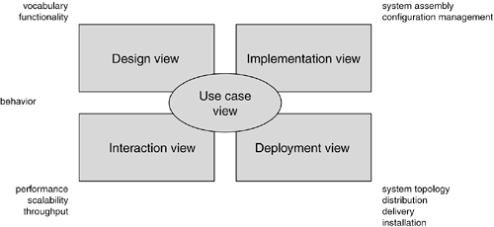
System architecture modeling
Chapter 1: Why do we Model things
Victor Stany Rozario
S.45

Slide 46
Uml architecture
Chapter 1: Why do we Model things
Victor Stany Rozario
S.46
Visualizing, specifying, constructing and documenting a software intensive system demands that the system be viewed from a number of perspectives (e.g., ATM system development design in several diagram drawing perspective).
Different stakeholders- end users, analysts, developers, system integrators, testers, technical writers and project managers- each bring different agenda to a project, and each looks at that system in different ways at different times over the project’s life.
1. The use case view of a system encompasses the use cases that describe the behavior of the system as seen by its end users, analysts, and testers. With the UML, the static aspects of this view are captured in use case diagrams; the dynamic aspects of this view are captured in interaction diagrams, state diagrams, and activity diagrams.

Slide 47
Uml architecture
Chapter 1: Why do we Model things
Victor Stany Rozario
S.47
2. The design view of a system encompasses the classes, interfaces, and collaborations that form the vocabulary of the problem and its solution. This view primarily supports the functional requirements of the system, meaning the services that the system should provide to its end users. With the UML, the static aspects of this view are captured in class diagrams and object diagrams; the dynamic aspects of this view are captured in interaction diagrams, state diagrams, and activity diagrams.
3. The interaction view of a system shows the flow of control among its various parts, including possible concurrency and synchronization mechanisms. This view primarily addresses the performance, scalability, and throughput of the system. With the UML, the static and dynamic aspects of this view are captured in the same kinds of diagrams as for the design view, but with a focus on the active classes that control the system and the messages that flow between them.

Slide 48
Uml architecture
Chapter 1: Why do we Model things
Victor Stany Rozario
S.48
The implementation view of a system encompasses the artifacts that are used to assemble and release the physical system. This view primarily addresses the configuration management of the system's releases, made up of somewhat independent files that can be assembled in various ways to produce a running system. It is also concerned with the mapping from logical classes and components to physical artifacts. With the UML, the static aspects of this view are captured in artifact diagrams; the dynamic aspects of this view are captured in interaction diagrams, state diagrams, and activity diagrams.
5. The deployment view of a system encompasses the nodes that form the system's hardware topology on which the system executes. This view primarily addresses the distribution, delivery, and installation of the parts that make up the physical system. With the UML, the static aspects of this view are captured in deployment diagrams; the dynamic aspects of this view are captured in interaction diagrams, state diagrams, and activity diagrams.

Slide 49
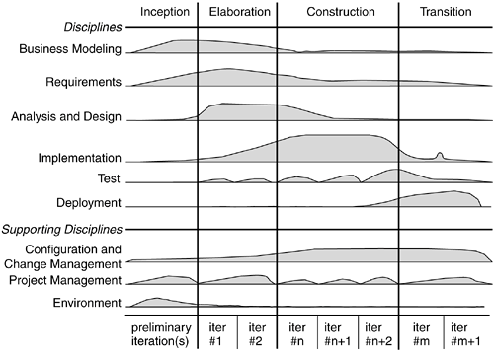
SDLC – Rational Unified Model (RUP)
Chapter 1: Why do we Model things
Victor Stany Rozario
S.49

Slide 50
SDLC – Rational Unified Model (RUP)
Chapter 1: Why do we Model things
Victor Stany Rozario
S.50
Inception is the first phase of the process, when the seed idea for the development is brought up to the point of being at least internally sufficiently well-founded to warrant entering into the elaboration phase.
Elaboration is the second phase of the process, when the product requirements and architecture are defined. In this phase, the requirements are articulated, prioritized, and baselined. A system's requirements may range from general vision statements to precise evaluation criteria, each specifying particular functional or nonfunctional behavior and each providing a basis for testing.
Construction is the third phase of the process, when the software is brought from an executable architectural baseline to being ready to be transitioned to the user community. Here also, the system's requirements and especially its evaluation criteria are constantly reexamined against the business needs of the project, and resources are allocated as appropriate to actively attack risks to the project.

Slide 51
SDLC – Rational Unified Process (RUP)
Chapter 1: Why do we Model things
Victor Stany Rozario
S.51
Transition is the fourth phase of the process, when the software is delivered to the user community. Rarely does the software development process end here, for even during this phase, the system is continuously improved, bugs are eliminated, and features that didn't make an earlier release are added.
Iteration is a distinct set of work tasks, with a baselined plan and evaluation criteria that results in an executable system that can be run, tested, and evaluated.

Slide 52
references
Chapter 1: Why do we Model things
Victor Stany Rozario
S.52
Booch, G., Rumbaugh, J. & Jacobson, I. (2005). The unified modeling language user guide. Pearson Education India.

